Slide 1
Object-Oriented Software Engineering
Practical Software Development using UML and Java
Chapter 5:
Modelling with Classes
Part 1

Slide 2
UML diagrams
  Class diagrams
    describe classes and their relationships
  Interaction diagrams
    show the behaviour of systems in terms of how objects interact with each other
  State diagrams and activity diagrams
    show how systems behave internally
  Component and deployment diagrams
    show how the various components of systems are arranged logically and physically
Chapter 5: Modelling with classes

Slide 3
5.2 Essentials of UML Class Diagrams
The main symbols shown on class diagrams are:
  Classes
      represents an object or a set of objects that share a common structure and behavior.
  Associations
      represent linkages between instances of classes
  Attributes
      are simple data found in classes and their instances
  Operations
      represent the functions performed by the classes and their instances
  Generalizations
      group classes into inheritance hierarchies
Chapter 5: Modelling with classes

Slide 4
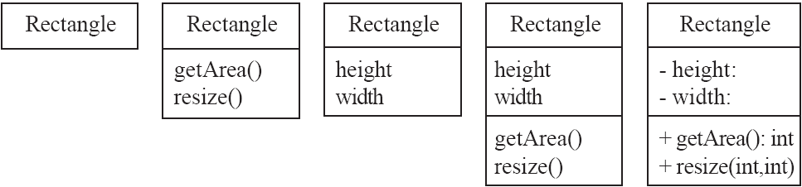
Classes
A class is simply represented as a box with the name of the class inside(the name should always be singular and start with a capital letter.)
  The diagram may also show the attributes and operations
  The complete signature of an operation is:
    operationName(parameterName: parameterType …): returnType
Chapter 5: Modelling with classes

Slide 5
5.3 Associations and Multiplicity
An association is used to show how two classes are related to each other
  The association is drawn as a line between the classes.
  Symbols indicating multiplicity are shown at each end of the association.
  The multiplicity indicates how many instances of the class at this end of the association can be linked to an instance of the class at the other end of the association.
Chapter 5: Modelling with classes

Slide 6

5.3 Associations and Multiplicity
A multiplicity of 1 indicates that there must be exactly one instance linked to each object at the other end of the association. There can only be one Company associated with each Employee.
A very common multiplicity is ∗, which is normally read as ‘many’, and means any integer greater than or equal to zero. Many employees can be associated with a company; one possibility being that a company has no employees. 0..* or *
Chapter 5: Modelling with classes

Slide 7

5.3 Associations and Multiplicity
If there can be either zero or one object linked to an object at the other end of the association, then the multiplicity is said to be ‘optional’, and the notation 0..1 is used.
There can be zero or one office per employee. In other words, it is optional that an employee is assigned to an office (some may work at home or in a job that does not require an office).
Chapter 5: Modelling with classes

Slide 8

5.3 Associations and Multiplicity
The multiplicity can be a specific positive integer; and you can also specify several multiplicity values or ranges separated by commas.
For example, imagine that the law in some jurisdiction states that a board of directors must have between three and eight members. Furthermore, if the board finds itself with insufficient members, then it is automatically dissolved and new elections must be held – during the election process, the board has zero members.
Figure below reflects this situation: there can be either zero, or between 3 and 8 persons on a BoardOfDirectors.
Chapter 5: Modelling with classes

Slide 9

Labelling associations
  Each association can be labelled, to make explicit the nature of the association.
  An association name should be a verb or verb phrase, and is placed next to the middle of the association. One class becomes the subject and the other class becomes the object of the verb.
  For example, the association between Employee and Company is called worksFor. You can read the association in one direction as,
  ‘an employee works for a company’.
Chapter 5: Modelling with classes

Slide 10

Labelling associations
The direction to read the association is normally obvious, but can be clarified by showing a little arrow (a filled triangle) next to the association name
Chapter 5: Modelling with classes

Slide 11

Labelling associations
Another way of labeling an association is to use a role name.
Role names can be attached to either one or both ends of an association.
A role name acts, in the context of the association, as an alternative name for the class to which it is attached.
For example, in the association between Person and BoardOfDirectors,
boardMember is a role name that describes the people who happen to be members of the board.
You can read this association as, ‘a board of directors has either zero or 3 to 8 persons as board members’.
Chapter 5: Modelling with classes

Slide 12

Labelling associations
If you omit both the association name and role names, then consider that an association’s name is simply has, by default.
For example, in the association between Company and BoardOfDirectors, the association would read, ‘a company has a board of directors.
Add sufficient names to make the association clear and unambiguous.
Chapter 5: Modelling with classes

Slide 13
Analysing and validating associations
  It is very common to make errors when creating associations – it is particularly easy to get the multiplicity wrong.
  Read every association in both directions to verify that it makes sense.
Chapter 5: Modelling with classes

Slide 14
Analysing and validating associations
  Many-to-one
    A company has many employees
    An employee can only work for one company.
      This company will not store data about the moonlighting activities of employees!
    A company can have zero employees
      E.g. a ‘shell’ company
    It is not possible to be an employee unless you work for a company.
Employee
*
worksFor
1
Company
Chapter 5: Modelling with classes

Slide 15
Analyzing and validating associations
  Many-to-many
    An assistant can work for many managers
    A manager can have many assistants
    a one-to-one relationship would be typical between any particular administrative assistant and manager, but in general there are assistants who work for a group of managers, and managers who are so senior that they have a group of assistants.
    Some managers might have zero assistants.
    Is it possible for an assistant to have, perhaps temporarily, zero managers?
    ensure that at all times at least one manager supervises each administrative assistant.
*
1..*
*
*
*
*
Assistant
*
Manager
supervisor
Chapter 5: Modelling with classes

Slide 16
Analyzing and validating associations
  One-to-one
    For each company, there is exactly one board of directors
    A board is the board of only one company
    A company must always have a board
    A board must always be of some company
1
1
Chapter 5: Modelling with classes

Slide 17
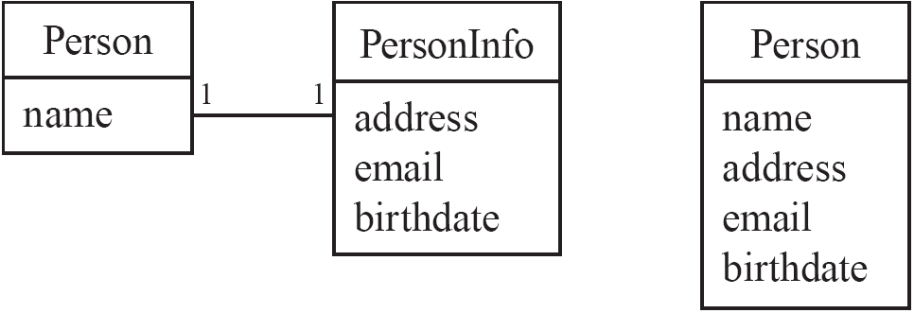
Analyzing and validating associations
Avoid unnecessary one-to-one associations.
A common error is to create a one-to-one association between two classes, where the two classes should really be one.
For example, in Person and PersonInfo should become a single Person class, with the attributes of PersonInfo transferred to Person.
Avoid this do this
Chapter 5: Modelling with classes

Slide 18
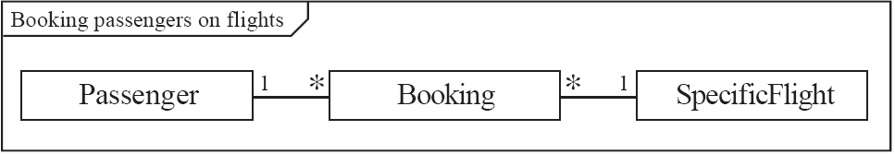
A more complex example
  The below Figure illustrates a possible multiplicity pattern involving three classes.
  For each Booking there must always be exactly one Passenger.
  But each Passenger can have any number of Bookings (i.e. on different flights and dates).
  Similarly, for each Booking there must always be exactly one SpecificFlight, but each SpecificFlight can have any number of Bookings (up to the capacity of the aircraft, of course).
Chapter 5: Modelling with classes

Slide 19
A more complex example
‘A Booking is always for exactly one Passenger’
This means there could never be a booking with zero passengers. Does this seem correct?
  Yes. After all, it would not make sense to have a booking if we did
  not know who the booking was for.
  The above association also implies that a Booking could never involve more than one Passenger.
    imagine an entire family sharing a single Booking to fly to some vacation spot.
      On the other hand, the alternative is that each member of the family has his or her own Booking.
Chapter 5: Modelling with classes

Slide 20
A more complex example
‘A Passenger can have any number of Bookings’
This statement says that a passenger could have no bookings at all. Does this seem reasonable?
    need further requirements analysis.
  One possibility is that we might not want to waste space storing
  information about a passenger who does not have any bookings – hence we may decide always to delete a passenger if he or she has just one booking and cancels it.
    then the multiplicity can be changed from ∗ to 1..∗.
It might be convenient to be able to add some passengers to the system and then later on to go back and add bookings.
    Therefore, we will conclude that allowing a Passenger to exist without a Booking is acceptable and leave the multiplicity at ∗.
Chapter 5: Modelling with classes

Slide 21
Exercise
Create two or three classes linked by associations to represent the situations below. Take care to specify appropriate multiplicity, as well as labels for the associations.
A video rental shop, where you must purchase a membership before renting anything.
A student taking courses in a school.
Chapter 5: Modelling with classes

